Slide 1
Chapter 1 Linux Kernel Module Programming
4 January, 2021
IN HO SONG
mearrong123@gmail.com
www.github.com/inhoinno

Slide 2
Chapter Objectives
Linux Kernel Module
Kernel?
Monologue Kernel vs MicroKernel
Linux Kernel Module?
What Kernel Module can do?
Why Write a Kernel Module?
Linux Kernel Module Programming
hello.ko, hello_PID.ko
en_workqueue.ko
Discussion & Future Study
Auditing workqueue: wq_module.ko
Summary

Slide 3
Kernel : Concepts
What is Kernel?
A resource manager who services multiple users with limited resources
Monolithic Kernel vs Micro Kernel
괴수 vs 조립로봇
Linux Kernel Module

Slide 4
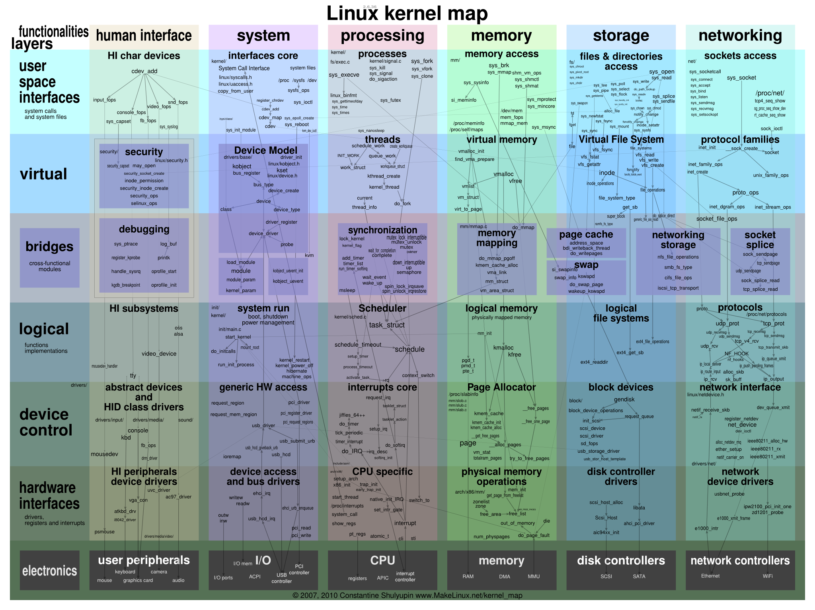
Kernel : Concepts
What is Kernel?
…

Slide 5
Kernel : Concepts
What is Kernel?

Slide 6
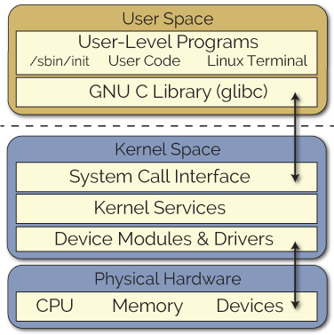
Kernel Module : Concepts
What is Kernel Module?
A piece of code that can load or remove code from Linux Kernel, at runtime
Why Write a Kernel Module?
Rule of thumb: try your absolute best to keep your code in user-space
//Application 만들듯 Kernel Module을 만드는 것은 위험
but interfacing electronic circuits with only low-level file operations?
This approach can appear to be inefficient
//(잘못된)비유: ioctl()만 가지고 모든 파일/장치를 관리하기
Linux user space and kernel space
[Ref]derekmolloy

Slide 7
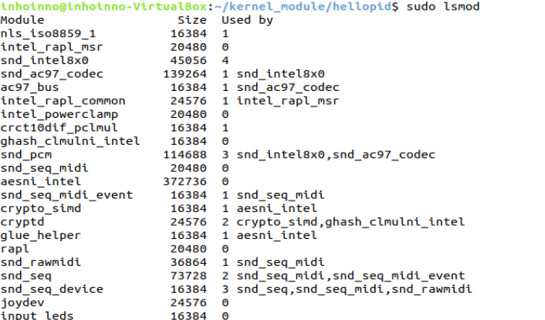
Various Linux Kernel Module
sudo lsmod
Device Driver
crypto
ip_tables
…

Slide 8
Background : Kernel Module
insmod %your_module%
or
modprobe %your_module%
rmmod %your_module%
Linux user space and kernel space
[Ref]derekmolloy

Slide 9
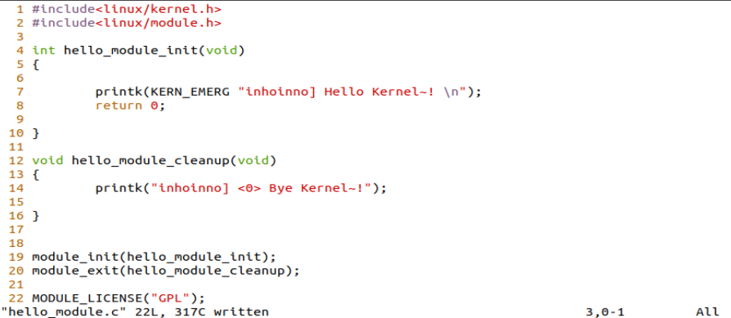
Linux Kernel Module : Example hello.ko
hello.c

Slide 10
Linux Kernel Module : Example hello.ko
hello.c
init, close, license
%module_name%_init
%module_name%_cleanup
MODULE_LICENSE(“GPL”)

Slide 11
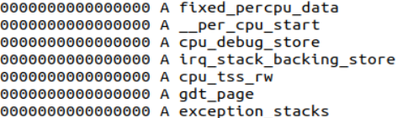
Linux Kernel Module : Example hello.ko
hello.c
커널 변수/함수 접근 : EXPORT_SYMBOL(var) → kallsyms
$ head /proc/kallsyms
$ cat /proc/kallsyms | grep -w printk
EXPORT_SYMBOL(var)
//var을 커널이나 모듈내에서 자유롭게 사용
모듈에 대해서 알아야 할 것들 https://tmdgus.tistory.com/117

Slide 12
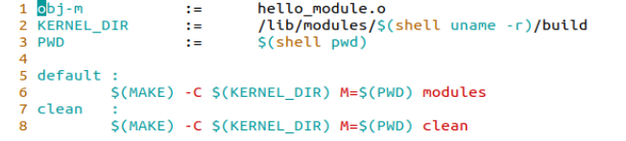
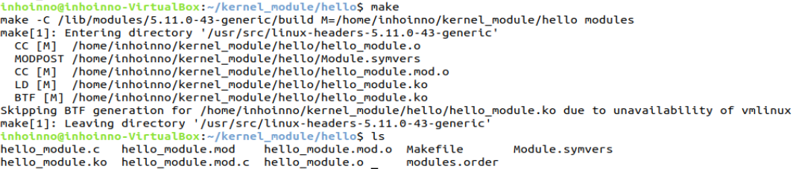
Linux Kernel Module : Example Makefile
Makefile
$ vim Makefile
$ make
$ ls

Slide 13
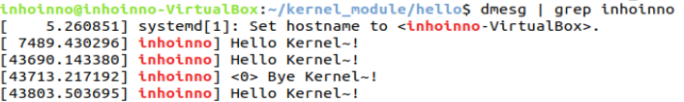
Linux Kernel Module : Example hello.ko
hello.ko
insmod
dmesg | grep “inhoinno”
rmmod
$ dmesg | grep “inhoinno”
$ lsmod | grep “hello”
$ insmod hello_module.ko
$ dmesg | grep “inhoinno”
$ rmmod hello_module.ko
$ dmesg | grep “inhoinno”
$ dmesg | grep “inhoinno”

Slide 14
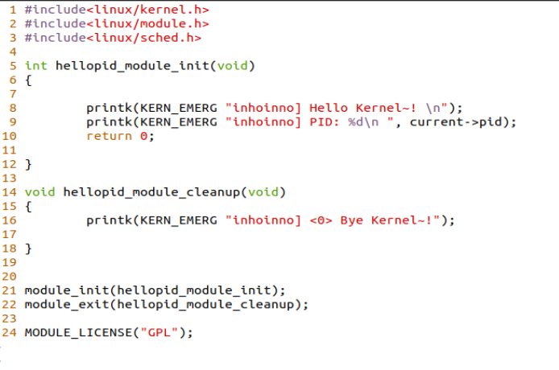
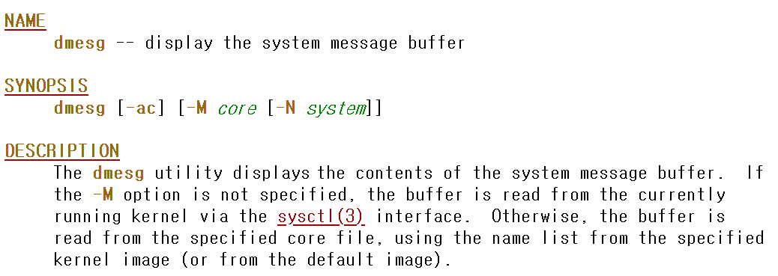
Linux Kernel Module : Example
hello_PID.c
$ dmesg | grep “inhoinno”
dmesg : display message buffer (in Kernel)
https://www.freebsd.org/cgi/man.cgi?dmesg

Slide 15
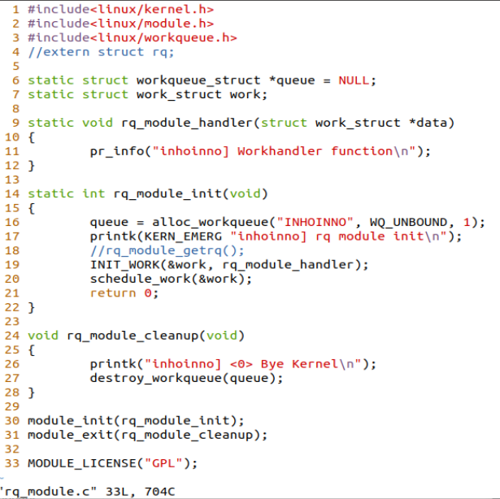
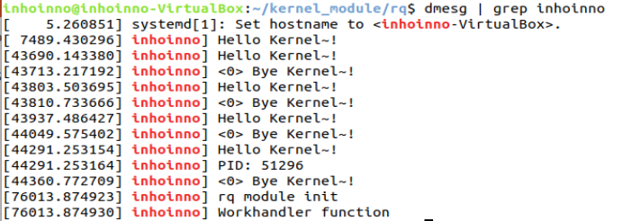
Linux Kernel Module : Example
en_workqueue.c
Linux Kernel Module Programming Guide v2.6 ch14.Scheduling Task:workqueue

Slide 16
Discussion & Future Study
Auditing Kernel
workqueue : wq_module.ko
io_uring : io_uring_audit_module.ko
Character Device Driver
[Stackoverflow] How to create a new Linux Kernel scheduler?
https://stackoverflow.com/questions/3086864/how-to-create-a-new-linux-kernel-scheduler
Add a new scheduler to the 2.6.34 vanilla kernel

Slide 17
Summary
Monolithic Kernel, Micro Kernel
Linux Kernel Module
Export Symbol
Linux Kernel Module Programming Example

Slide 18
References
Linux Kernel source
https://elixir.bootlin.com/linux/latest/source
PDF, Textbook
Linux Kernel Module Programming Guide
[원서] https://tldp.org/LDP/lkmpg/2.6/lkmpg.pdf
[번역] http://~/lkmpg_v2.6_by_YoonMin_Nam.pdf
Linux Kernel Example
[Git] Various example : https://github.com/psachin/kernel_modules
[Git] Greeter & Babel : https://github.com/dwmkerr/linux-kernel-module

Slide 19
Q & A

Slide 20
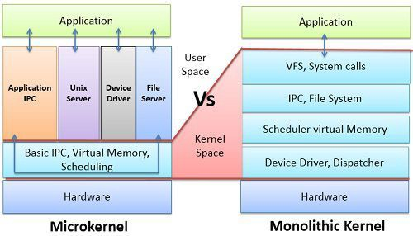
Appendix : Monolithic Kernel vs Micro Kernel
https://medium.com/@shrimantshubham/what-is-kernel-microkernel-and-monolithic-kernel-66c6de358b43

